Slide 1
Low Level Design (LLD) Customer Segmentation
Revision Number - 1.2
Last Date of Revision - 28/1/2022
AKASH

Slide 2
LOW LEVEL DESIGN (LLD)
Document Control
Date | Version | Description | Author
21/10/2021 | 1.0 | Introduction, Problem Statement | Akash Shetty
22/10/2021 | 1.1 | Dataset Information, Architecture Description | Akash Shetty
28/10/2021 | 1.2 | Final Revision | Akash Shetty

Slide 3
LOW LEVEL DESIGN (LLD)
Contents
Document Version Control…………………………………………………………………………2
1. Introduction……………………………………………………………………………………….4
1.1 What is Low Level Design Document?.................................................................4
1.2 Scope……………………………………………………………………………………4
1.3 Project Introduction……………………………………………………………………4
2. Problem Statement.……………………………………………………………………………...5
3. Dataset Information……………………………………………………………………….……...5
4. Architecture…………………………………………………………………………………….…6 4.1 Architecture Description …………………………………………….…....................6

Slide 4
LOW LEVEL DESIGN (LLD)
1. Introduction
1.1 What is Low Level Design Document?
The goal of the Low-level design document (LLDD) is to give the internal logic design of the actual program code for the Customer Segmentation Analysis . LLDD describes the class diagrams with the methods and relations between classes and programs specs. It describes the modules so that the programmer can directly code the program from the document.
What is Scope?
Low-level design (LLD) is a component-level design process that follows a step- by-step refinement process. The process can be used for designing data structures, required software architecture, source code and ultimately, performance algorithms. Overall, the data organization may be defined during requirement analysis and then refined during data design work.
Project Introduction
Not all customers are same. To know which group is your customer and their preferences is a big part for success in your business. Unsupervised machine learning can help marketers to know their audience globally and engage them with their products accordingly.
Here we can classify millions of people’s interests through their activity and also through other surveys online & offline and cluster them in specific group of their interest .

Slide 5
LOW LEVEL DESIGN (LLD)
2. Problem Statement
The goal of this project is to analyse to predict the group of cluster our customers belong, based on a combination of features that describes their spending and shopping habits. To achieve the goal, we used a data set that is formed by taking into consideration some of the information of 9000 individuals. The problem is based on the given information about each individual we have to calculate that whether that individual one of four different groups
3. Dataset Information
Dataset
The sample Dataset summarizes the usage behavior of about 9000 active credit card holders during the last 6 months. The file is at a customer level with 18 behavioral variables
Variables of Dataset
▪Balance
▪Balance Frequency
▪Purchases
▪One-off Purchases
▪Installment Purchases
▪Cash Advance
▪Purchases Frequency
▪One-off Purchases Frequency
▪Purchases Installments Frequency
▪Cash Advance Frequency
▪Cash Advance TRX
▪Purchases TRX
▪Credit Limit
▪Payments
▪Minimum Payments
▪PRC Full payment
▪Tenure
▪Cluster

Slide 6



LOW LEVEL DESIGN (LLD)
4. Architecture
Raw Data Collection
Data Pre- Processing
Data Cleaning
Real World
Deployment
Modelling
Exploratory Data Analysis (EDA)
Reporting
Architecture Description
Raw Data Collection
The Dataset was taken from internet.
Data Pre-Processing
Before building any model, it is crucial to perform data pre-processing to feed the correct data to the model to learn and predict. Model performance depends on the quality of data feeded to the model to train.
This Process includes-
Handling Null/Missing Values
Handling Skewed Data
Outliers Detection and Removal
Data Cleaning
Data cleaning is the process of fixing or removing incorrect, corrupted, incorrectly formatted, duplicate, or incomplete data within a dataset.
Remove duplicate or irrelevant observations
Filter unwanted outliers
Renaming required attributes

Slide 7
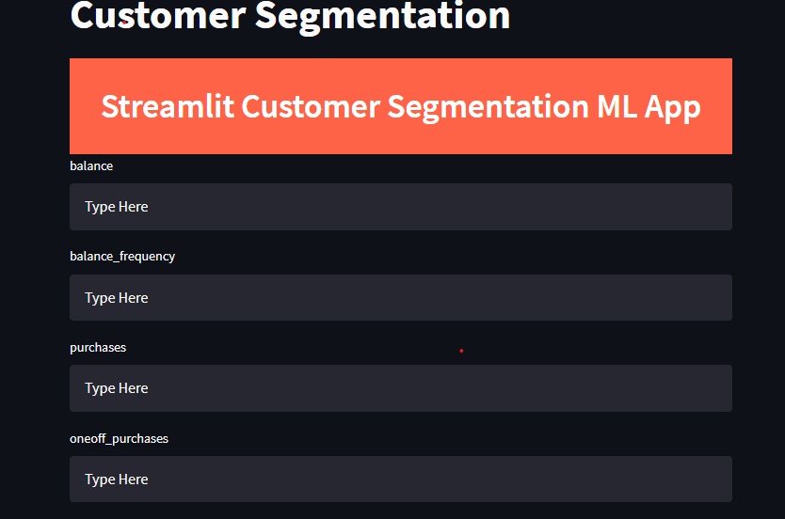
LOW LEVEL DESIGN (LLD)
Exploratory Data Analysis (EDA)
Exploratory Data Analysis refers to the critical process of performing initial investigations on data to discover patterns, spot anomalies, test hypothesis and to check assumptions with the help of summary statistics and graphical representations.
Reporting
Reporting is a most important and underrated skill of a data analytics field. Because being a Data Analyst you should be good in easy and self- explanatory report because your model will be used by many stakeholders who are not from technical background.
High Level Design Document (HLD)
Low Level Design Document (LLD)
Architecture
Wireframe
Detailed Project Report
Power Point Presentation
Modelling
Data Modelling is the process of analysing the data objects and their relationship to the other objects. It is used to analyse the data requirements that are required for the business processes. The data models are created for the data to be stored in a database. The Data Model's main focus is on what data is needed and how we have to organize data rather than what operations we have to perform.
Deployment
We created a Streamlit app

